Slide 1
Portfolio Project Luke Eaton
Analysis of Sleep Health Dataset
How can we improve our sleep?
Cambridge Spark Data Analytics Bootcamp

Slide 2
Contents
3-7. About the Dataset
3. Dataset & variables description
4. Sample Demographics: Gender & Age
5. Sample Demographics: Occupation
6-7. Visualising the Outcome Variables
8. Data Analysis Objectives
9-13. Analysis 1: Sleep vs. Demographic variables
9. Analysis 1: Key Questions
10. 1a) Sleep vs. Gender
11. 1b) Sleep vs. Age
12. 1a/b) Sleep: Age/Gender interaction
13. 1c) Sleep vs. Occupation
14-17. Analysis 2: Sleep vs. Exercise & Health
14. Analysis 2: Key Questions
15. 2ai) Sleep vs. Exercise & Fitness
16. 2aii) Exercise: Gender & Age Differences
17. 2b) Sleep vs. Blood Pressure & BMI
18-19. Analysis 3: Sleep vs. Stress
18. Analysis 3: Key Questions
19. 3) Sleep vs. Stress
20-22. Analysis 4: Sleep vs Sleep Disorders
20. Analysis 4: Key Questions
21. 4) Sleep vs. Sleep Disorders
22. 4) Sleep disorders: Gender & Age Differences
23-26. Summary, Recommendations, & Further Analyses
23. Recommendations: Key Questions
24. Recommendations: Age, Gender, Occupation, Exercise/Physical Activity
25. Recommendations: Blood Pressure & Body
Weight, Stress, Sleep Disorders
26. Recommendations for Further Analyses

Slide 3
About the Dataset
The outcome variables include 2 sleep metrics:
Sleep duration – as a self-reported measurement, given in hours.
Quality of sleep – as a self-reported, subjective rating on a scale from 1-10.
There are 3 demographic variables:
Gender, age, and occupation.
Experimental variables include:
Health variables: Some relate to exercise & fitness: physical activity, daily steps, and heart rate. Some may relate more to diet: BMI category and blood pressure.
Stress level – as a self-reported, subjective rating on a scale from 1-10.
Sleep disorder – the presence (& type), or absence, of a sleep disorder
The original dataset contained 374 entries; however, there were 242 duplicates, so these entries were removed. There were no missing values. Therefore the final dataset contained 132 entries.
The dataset analysed is a synthetic dataset, and can be found here:
www.kaggle.com/datasets/uom190346a/sleep-health-and-lifestyle-dataset/data

Slide 4
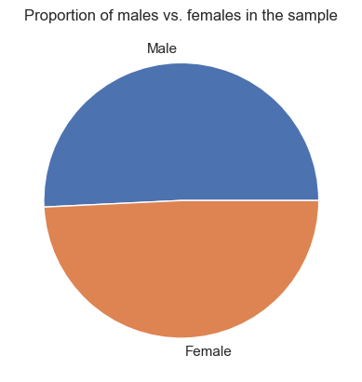
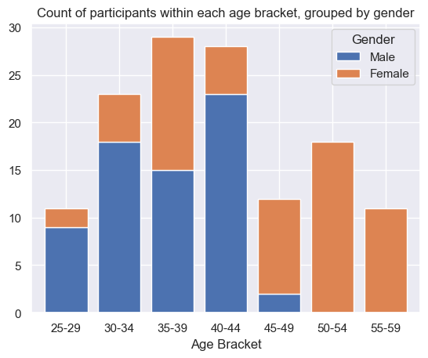
About the Dataset: Sample Demographics: Gender & Age
The dataset is roughly evenly split between males and females.
However, the males in the dataset tend to be younger: the mean male age is 36.57, whereas the mean female age is 45.83. There are also no males above the age of 50.
So, gender differences in sleeping patterns in this sample could be partly mediated by age.
Gender | Count
Male | 67
Female | 65
Ages in the sample ranged from 25-59, with an overall mean age of 41 (SD = 8.81).
Therefore, the different sleeping patterns of teenagers will not be represented. Likewise, elderly people (>=60) are not represented.
Further, the dataset is slightly skewed towards older adults & middle-aged people (30-45).
Interactions between age and other variables should be investigated in the analysis.
Age | Male | Female | Total
25-29 | 9 | 2 | 11
30-34 | 18 | 5 | 23
35-39 | 15 | 14 | 29
40-44 | 23 | 5 | 28
45-49 | 2 | 10 | 12
50-54 | 0 | 18 | 18
55-59 | 0 | 11 | 11
Count

Slide 5
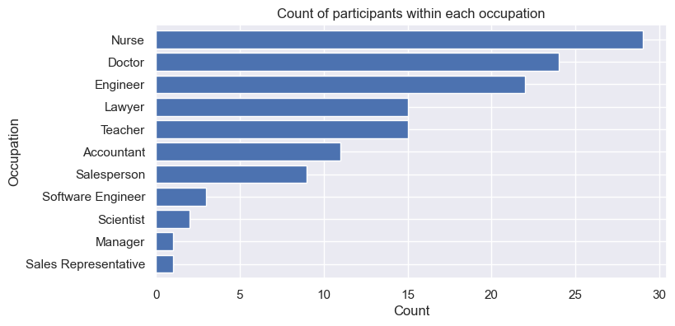
About the Dataset: Sample Demographics: Occupation
The dataset contains a large number of people from the medical profession, with nurses and doctors together making up 40% of the sample.
The sleep habits of these people could be different, as they may have better knowledge of sleep hygiene, for example.
Also, occupations involving manual labour are poorly represented.
These jobs may require more physical rest; alternatively, people in these jobs could be fitter. The results may not generalise to people in these occupations.
Occupation | Count
Nurse | 29
Doctor | 24
Engineer | 22
Teacher | 15
Lawyer | 15
Accountant | 11
Salesperson | 9
Software Engineer | 3
Scientist | 2
Sales Representative | 1
Manager | 1

Slide 6
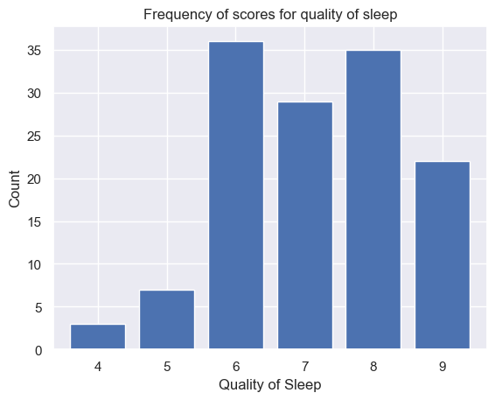
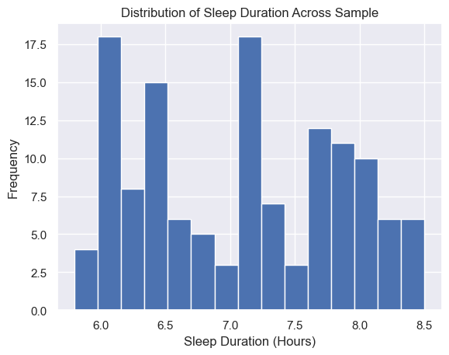
About the Dataset: Visualising the Outcome Variables
Sleep Quality
Sleep quality scores ranged from 4-9, with a mean score of 7.15 (SD = 1.27)
Most participants (92%) reporting a score in the top half of the scale (6-10).
Roughly the same number of participants gave scores of 6, 7, and 8, with around 1/3 fewer giving a score of 9, and none giving a perfect score of 10.
Sleep Duration
Scores for sleep duration ranged from 5.8-8.5, with a mean score of 7.08 (SD = 0.78).
Very few participants slept for fewer than 6 hours, and relatively few slept for more than 8 hours.
There are spikes in the distribution: the mode score is 7.2 hours (11 participants), followed by 6.5 hours (10 participants), and then jointly followed by 6.0 and 6.1 hours (9 participants). Sleeping for a round number of hours may be more common.

Slide 7
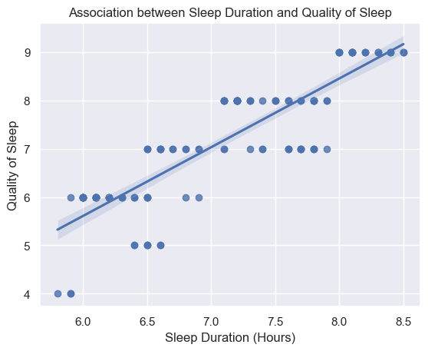
About the Dataset: Visualising the Outcome Variables
Further, there is a positive correlation between Sleep Duration and Quality of sleep.
Sleeping longer tends to occur with subjective ratings of better quality sleep.
If there is a causal relationship, we can’t infer the direction:
Sleeping longer may cause people to feel their sleep is better quality.
Having better quality sleep may cause people to sleep longer.

Slide 8
Data Analysis Objectives
Objective A) Determine the relationship between sleep and demographic factors.
Analysis 1) Are gender, age, and occupation associated with sleep duration/quality?
Objective B) Determine the relationship between sleep and health factors: exercise, weight, stress, and sleep disorders.
Analysis 2) Are physical activity, BMI category, heart rate, and blood pressure associated with sleep duration/quality?
Analysis 3) Is stress level associated with sleep duration/quality?
Analysis 4) How are different sleep disorders associated with sleep duration/quality?
Give recommendations for improving sleep.
Could changing occupation, increasing exercise, losing weight, reducing stress, or treating sleep disorders improve sleep quality/duration?

Slide 9
Analysis 1 How are Gender, Age, and Occupation Related to Sleep Quality & Duration?
Key Questions
Should recommendations for improving sleep differ for people of different age groups, for males and females, or for people in different occupations?
Could changing occupation help improve sleep?

Slide 10
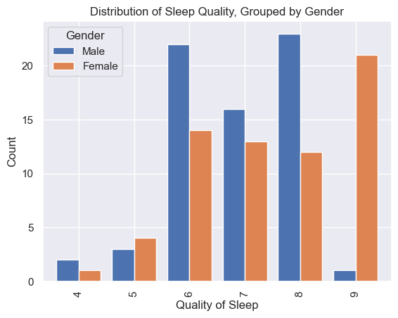
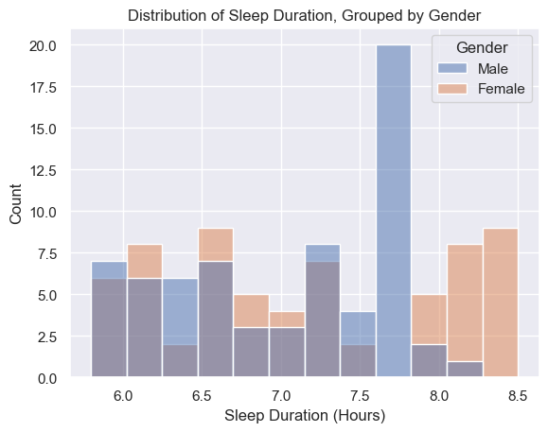
1a) Sleep vs. Demographic Factors: Gender
Sleep Quality
Females have a higher mean quality of sleep (7.45) than males (6.87).
People with lower quality sleep (4-5) are relatively evenly split by gender.
A slightly higher proportion of people with middle-high quality sleep (6-8) are male than female.
An overwhelming majority of people with very high quality sleep (9) are female.
Sleep Duration
Females also have a slightly higher mean sleep duration (7.15 hours) than males (7.01).
The distribution of sleep durations under 7.5 hours is roughly evenly split by gender.
There is a spike in males who sleep between 7.5 and 7.75 hours.
The majority of people who sleep over 7.5 hours are female.
Key takeaway: Females tend to have sleep of a higher quality and a longer duration than males.

Slide 11
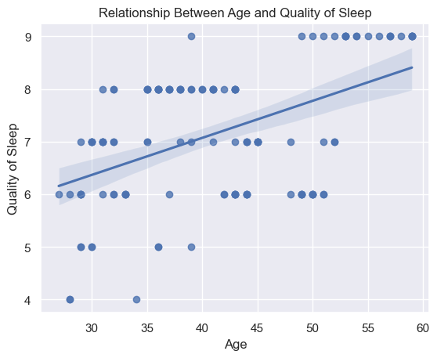
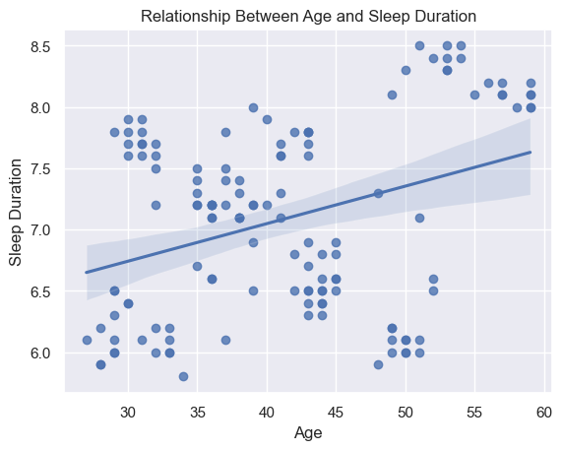
1b) Sleep vs. Demographic Factors: Age
Sleep Quality
Quality of sleep is positively correlated with age.
Almost all people with the highest score for sleep quality (a score of 9) are aged over 50.
Sleep Duration
There is also a positive correlation between age and sleep duration.
Almost all people who sleep for 8 hours of more are aged over 50.
Key takeaway: Sleep quality and sleep duration tend to increase with age.

Slide 12
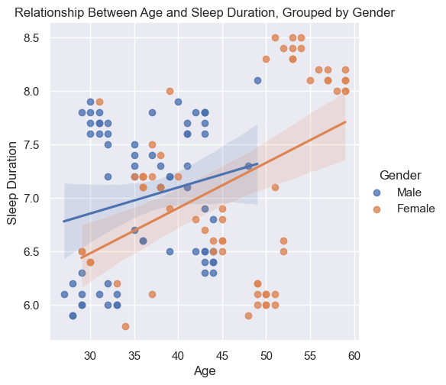
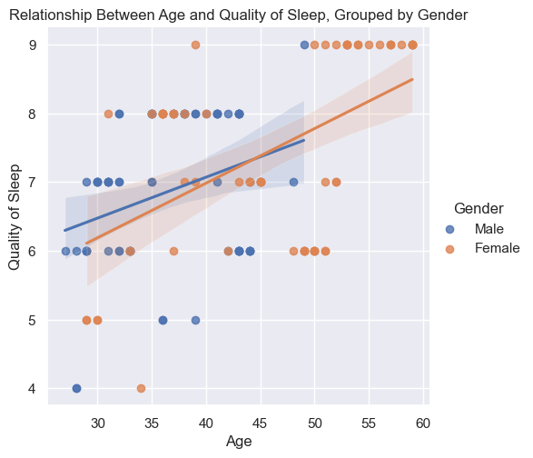
1a/b) Sleep vs. Demographic Factors: Age/Gender interaction
However, it is possible that there is an interaction effect between gender and age.
There appears to be a stronger positive correlation between sleep quality/duration and age for females than for males, but this may be due to the presence of females older than 50 in the sample and no males older than 50).
As people aged above 50 tend to have higher sleep duration/quality, this may skew the values for the female group, causing females to appear to have higher sleep quality/duration. However, in reality, this effect could be caused by age.
It is unlikely that the mediation effect is in the other direction (i.e., a gender difference causing an age difference to appear), as both sleep duration and quality are similar for males & females who are within the same age brackets.
Further analyses could sample more participants, such that there are similar age distributions between males and females, in order to determine whether age is mediating the relationship between gender and sleep quality/duration observed in this analysis.
Key takeaway: Any differences attributed to gender in our analyses may in fact be due to age.

Slide 13
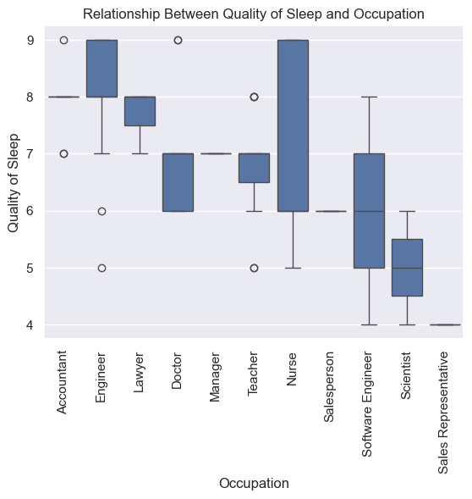
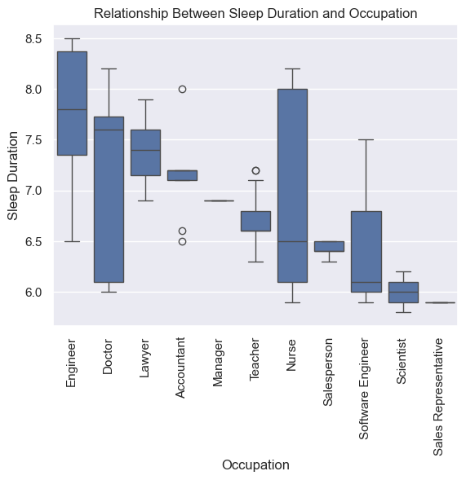
1c) Sleep vs. Demographic Factors: Occupation
The 3 occupations with the highest sleep quality are: Accountant, Engineer, and Lawyer.
Further, those with the longest sleep duration are: Engineer, Doctor, and Lawyer.
The 3 occupations with both the lowest sleep quality and shortest sleep duration are: Sales Representative, Scientist, and then Software Engineer.
However, there is no clear thematic link between the occupations in these groups.
Although, these results should be taken with caution, as the sample sizes for many of these occupations are very small.
In particular, 4 groups have sample sizes smaller than 5: Software Engineer (3 participants), Scientist (2), Sales Representative (1), and Manager (1).
A larger sample may be needed to determine whether occupation is related to sleep quality/duration.
Key takeaway: There is no clear theme which directly links the occupation with the best sleep.

Slide 14
Analysis 2 What is the Relationship Between Sleep and Exercise, Fitness, and Health?
Key Questions
Could doing more exercise and increasing fitness improve sleep?
Does this depend on age or gender?
How are diet and weight related to sleep? Could losing weight improve sleep?

Slide 15
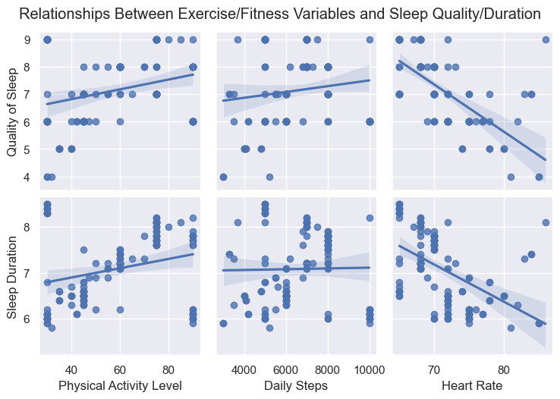
2ai) Sleep vs. Health: Exercise & Fitness
Our analyses indicate that exercise is positively correlated with sleep quality & duration as shown by the two exercise measures Physical Activity Level and Daily Steps.
Likewise, there is a negative correlation between Heart Rate and sleep quality & duration. As a lower heart rate indicates fitness, fitness also appears positively correlated with sleep duration/quality.
Key takeaway: Exercise and fitness are positively correlated with sleep quality & duration.

Slide 16
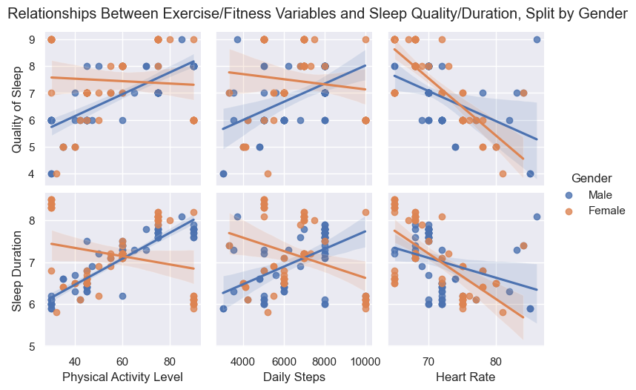
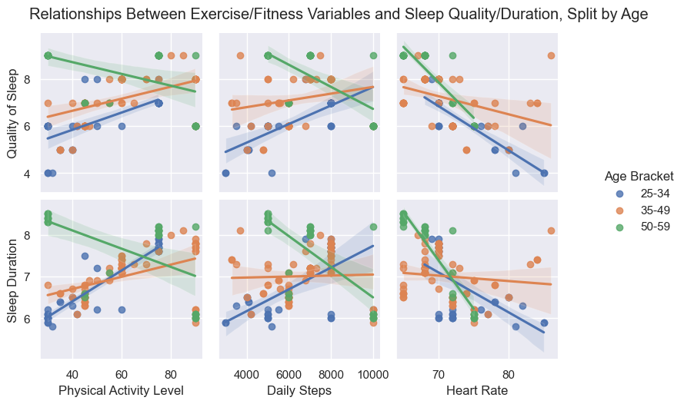
2aii) Sleep vs. Health: Exercise & Fitness: Gender & Age Differences
There is a positive correlation between exercise (Physical Activity Level and Daily Steps) and sleep quality/duration for males, but there may be no association, or even a negative correlation, for females. However, this difference may be due to the older ages of the females in the sample.
Indeed, there is an interaction between age and the relationship between exercise and sleep: as age increases, the correlation between exercise and sleep changes from positive to negative. Perhaps, for older people, the wearing effects of exercise on the body outweigh the benefits.
However, fitness (as inversely associated with Heart Rate) is positively associated with sleep quality and duration, regardless of age and gender. Perhaps, for older people, exercise is detrimental to sleep in the short-term, but beneficial in the long-term.
Key takeaways: Exercise may improve younger people’s sleep, but be bad for older people’s sleep.
Fitness may be good for sleep quality/duration regardless of age.

Slide 17
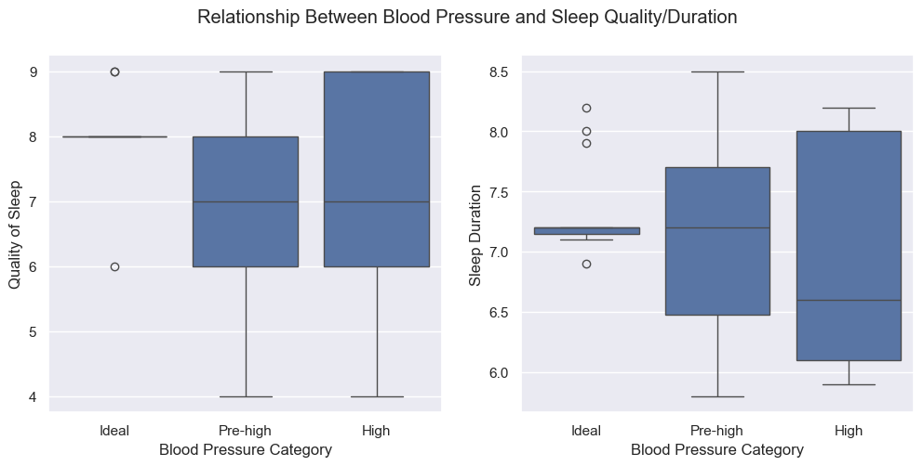
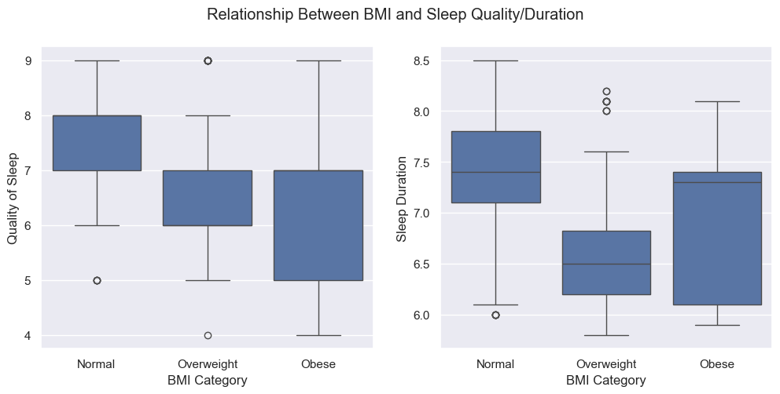
2b) Sleep vs. Health: Blood Pressure & BMI
High and pre-high blood pressure is associated with sleep of lower quality and shorter duration than ideal blood pressure
Likewise, higher body weight is associated with worse, shorter sleep.
However, this relationship may be more complex: those with the highest body weight (obese) tend to sleep for longer than those in the middle category (overweight), despite their sleep being of worse quality.
Key takeaway: Overall, blood pressure and body weight are negatively correlated with sleep quality & sleep duration.
Blood Pressure Category | Mean Quality of Sleep | Mean Sleep Duration
Ideal | 8.00 | 7.33
Pre-high | 7.01 | 7.11
High | 7.12 | 6.89
BMI Category | Mean Quality of Sleep | Mean Sleep Duration
Normal | 7.51 | 7.34
Over- weight | 6.77 | 6.74
Obese | 6.29 | 6.90

Slide 18
Analysis 3 What is the relationship between stress and sleep?
Key Questions
Could reducing stress be a good target for improving sleep?
If stress affects sleep, does this effect change with age or gender?

Slide 19
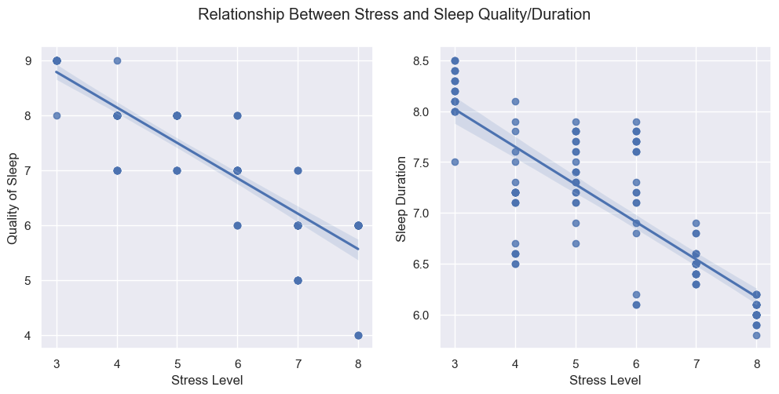
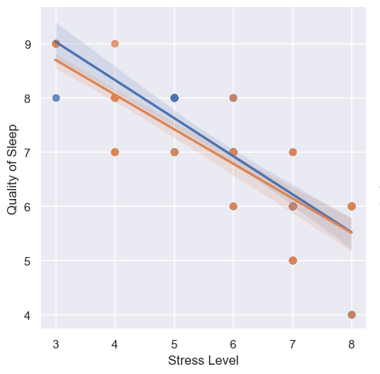
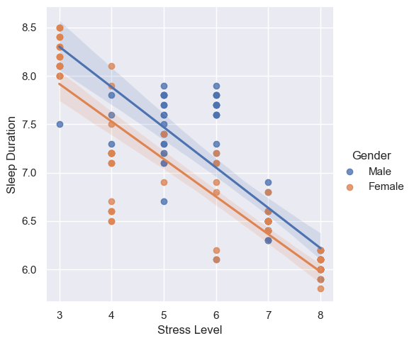
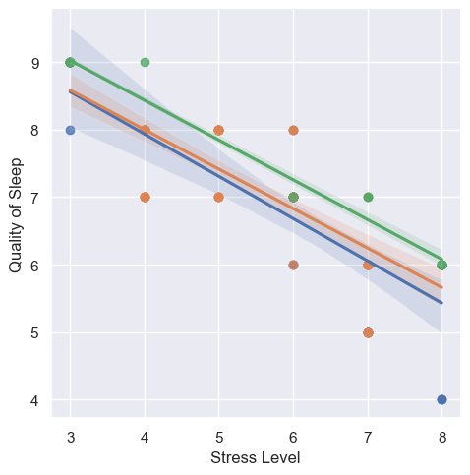
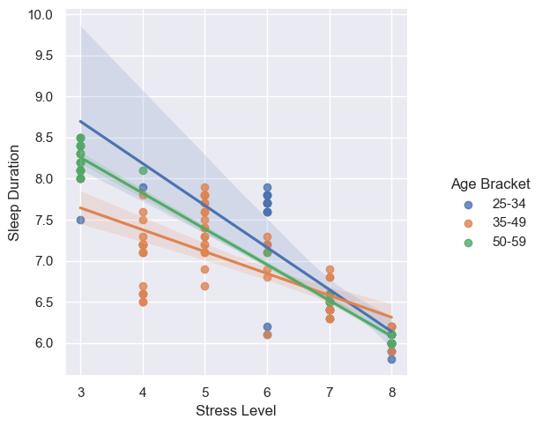
3) Sleep vs. Stress
There is a negative correlation between Stress and both sleep quality and duration.
Further, this relationship is seen regardless of both gender and age.
Relationship Between Stress and Sleep Quality/Duration, Split by Gender
Relationship Between Stress and Sleep Quality/Duration, Split by Age
Key takeaway: Increased stress is consistently associated with worse, shorter sleep, regardless of age and gender.

Slide 20
Analysis 4 How much do sleep disorders reduce sleep quality/duration?
Key Questions
To what extent could treating sleep disorders improve sleep?
Would sufferers’ sleep quality/duration still be much lower than average if sleep could be improved by targeting other factors, such as exercise, weight, stress?
Are sleep disorders associated with an irredeemable reduction in sleep quality/duration?
Do different ages/genders tend to have different sleep disorders?
Should interventions/recommendations be targeted by age/gender?

Slide 21
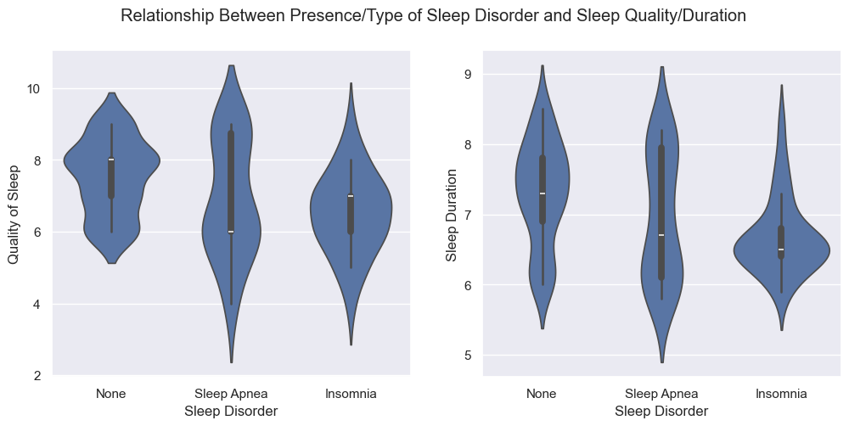
4) Sleep vs. Sleep Disorders
In our sample, most people did not have a sleep disorder (55%). Sleep apnoea and insomnia were roughly equally common.
Sleep disorders tended to reduce both sleep quality and duration, although not massively.
Insomnia is associated with a larger reduction in sleep duration than sleep apnoea.
However, it is unclear from our analyses if either sleep disorder is associated with a larger reduction in sleep quality: insomnia has a lower mean score for quality of sleep than sleep apnoea (6.52 vs. 6.87), but insomnia also has a higher median score (7 vs. 6).
Sleep Disorder | Count
None | 73
Sleep Apnoea | 30
Insomnia | 29
Sleep Disorder | Mean Quality of Sleep | Mean Sleep Duration
None | 7.52 | 7.30
Insomnia | 6.52 | 6.68
Sleep Apnoea | 6.87 | 6.94
Sleep Disorder | Median Quality of Sleep | Median Sleep Duration
None | 8.0 | 7.3
Insomnia | 7.0 | 6.5
Sleep Apnea | 6.0 | 6.7
Key takeaway: Insomnia and sleep apnoea are associated with a modest reduction in sleep quality and duration.

Slide 22
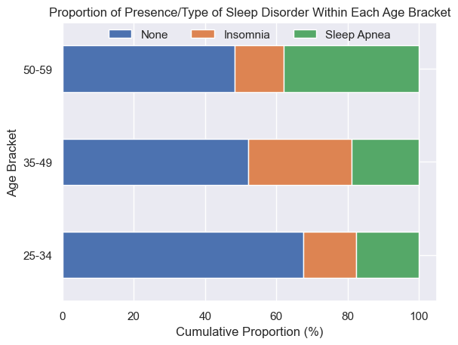
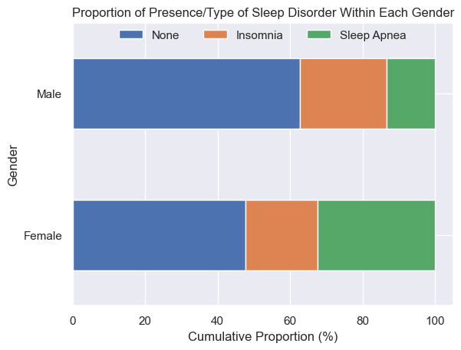
4) Sleep vs Sleep Disorders: Age & Gender Differences
The prevalence of sleep disorders increases with age. Younger people (aged 25-34) have a lower prevalence of sleep disorders overall (~32%). Yet, almost half of each of the two older age brackets have a sleep disorder.
Compared to the other age brackets, a higher proportion of middle-aged people (aged 35-49) suffer from insomnia: 29% vs 15% (younger) & 14% (older).
Compared to other ages, more older people (aged 50-59) suffer from sleep apnoea: 38% vs 18% (younger) & 19% (middle-aged).
A higher proportion of females than males have a sleep disorder (52% vs 37%); this is largely driven by a higher rate of sleep apnoea in females (32% vs 13%).
Again, this could be due to the skew towards older people (who are more likely to have sleep apnoea in the females in the sample.
Age Bracket | Sleep Disorder (%)
 | None | Insomnia | Sleep Apnoea
25-34 | 67.65 | 14.71 | 17.65
35-49 | 52.17 | 28.99 | 18.84
50-59 | 48.28 | 13.79 | 37.93
Gender | Sleep Disorder (%)
 | None | Insomnia | Sleep Apnoea
Female | 47.69 | 20.00 | 32.31
Male | 62.69 | 23.88 | 13.43
Key takeaway: More middle-aged people have insomnia; more older people (& maybe females) have sleep apnoea.

Slide 23
Summary, Recommendations, & Further Analyses
Could sleep be improved by approaches targeting occupation, exercise, fitness, diet, weight, and stress?
Should recommendations differ, depending on age or gender?
How much could people with sleep disorders benefit?
What next steps could be taken to build upon the results of this analysis?

Slide 24
Summary & Recommendations P1
Age: Quality and duration of sleep tends to increase as we age.
Taking action to improve sleep may be particularly important for younger & middle-aged people.
Gender: Our analyses suggested that females may have higher quality, longer sleep. However, this effect may be misleading, due to a problem with the sample: the female age distribution skewed towards older people than the male age distribution.
We can’t conclude whether advice should differ between males and females.
Occupation: There is no clear link between occupation type and sleep quality/duration.
Changing occupation may not in itself improve sleep.
Exercise/physical activity is positively correlated with the quality & duration of young people’s sleep, but this correlation becomes negative with age. However, fitness is associated with higher sleep quality & duration, regardless of age.
Younger people could exercise and build fitness to improve sleep.
Older people should be careful not to over-exert themselves: exercise may worsen sleep, although perhaps only in the short-term. However, building fitness could still their improve sleep. Improving body health through approaches other than exercise may be more beneficial.

Slide 25
Summary & Recommendations P2
Blood pressure and body weight are both negatively correlated with sleep quality & duration.
Diet can play an important role in improving sleep. Reducing blood pressure could help – perhaps by reducing salt intake. Although BMI can’t be controlled by diet alone, any approach to losing weight could help.
These approaches may be especially beneficial to older people, for whom exercise could worsen sleep.
Stress is consistently associated with sleep of worse quality and shorter duration, regardless of age or gender.
Reducing stress, or practising techniques to cope with stress, is a great approach for everyone. This could include meditation, social support, exercise, prioritising relaxation, etc.
Sleep disorders (both insomnia and sleep apnoea) are associated with both reduced sleep quality and duration. Insomnia is more common in middle-aged people than other ages, as is sleep apnoea in older people.
Middle-aged people could consider treatments for insomnia: perhaps increasing exercise or reducing stress.
Older people should consider getting tested for sleep apnoea. They could also seek help – perhaps reducing weight through diet.
Further, the effect of sleep disorders is not huge – so sufferers still have hope, and a small improvement in sleep, perhaps through targeting the other factors, may raise sleep quality/duration to average.

Slide 26
Further Analyses
Larger sample: The analyses should be repeated with a larger sample, where the age distributions of each gender are similar, in order to determine whether the gender differences seen in these analyses are valid (and not in fact due to age differences).
Do females really have better sleep? Is exercise really more important for males? Is sleep apnoea really more common in females than males?
More confidence in these gender effects is necessary in order to make sleep recommendations based on gender.
Statistical tests: The effects seen in this analysis should be tested for statistical significance, including the differences in means and any interaction effect between age and gender. This will test the validity of the effects seen, and is essential for confidence in any conclusions.
Testing interventions: The conclusions of our analyses could form the basis for interventions to improve sleep, for example: exercise routines, diet regimes, meditation courses, or sleep disorder treatment. Further analyses should test the effects of such interventions to make firm recommendations for improving sleep quality and duration.

